Slide 1
Capstone Project
IBM applied Final Project
By
William Ho

Slide 2
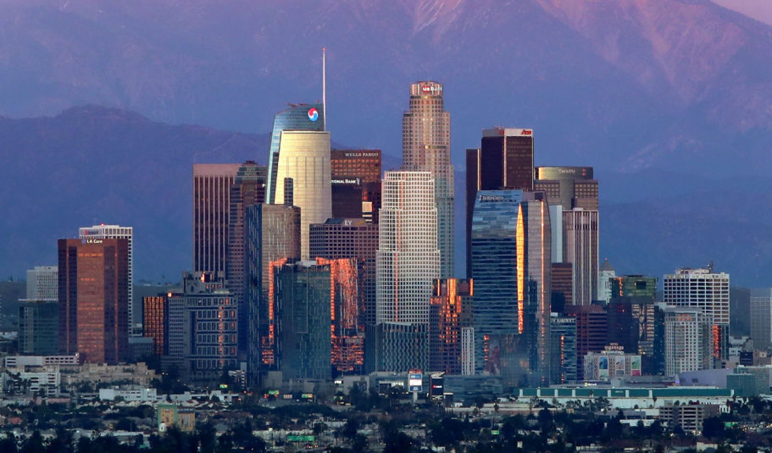
Introduction
Los Angeles is the second largest city in the United States of America
It is the best place for people to immigrate to
It known for Hollywood and also sunny weather

Slide 3

Business Information
Client Information:
New immigrant from China
Middle class income group
Chinese Restaurant owner in China
Under budget to own house in US

Slide 4

Data Information
FourSquare API
Los Angeles neighborhood with ZIP Code and Coordinates
A set of data from Zillow that consists of every ZIP code in US with its average housing code

Slide 5

Methodology
The Scikit learn package is used to perform KMean cluster calculation
Folium package also used to visualize the map in the Jupyter notebook
Pandas is used to visualize the dataset
Numpy is used to perform array computation

Slide 6
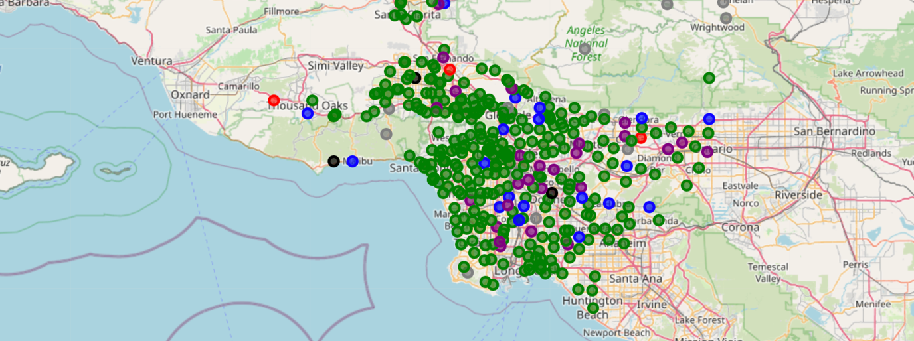
Sample Map of LA cluster
This is the map for los angeles with the marker with different cluster labeled

Slide 7
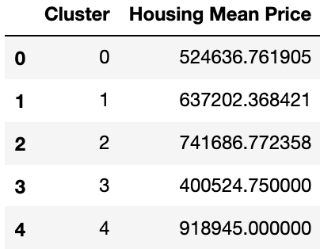
The Cluster by Average Housing Price

Slide 8
Conclusion
The most recommeded cluster will be cluster 1 and 2
The housing price for cluster 2 is higher than cluster 1. However, the neighborhood is cluster 1 is more convenience and consists of more immigrant
For housing 1, it is a less happening cluster. However, its housing price is lower and the less competitive for client to start the business

